Slide 1

Mat - Fit
Team Random

Slide 2
Introduction
PART ONE
Athlete
Data Collection
PART TWO
Runrunrun, walkwalkwalk,
cyclecyclecycle
Machine Learning
PART THREE
Prediction of types of activity

Slide 3
PART 01
Introduction

Slide 4

Meet Zhi Yu
Age: 23
Weight: 76 kg
Height: 180 m
Resting Heart Rate: 71 bpm
Sitting Heart Rate: 82 bpm
Strides (ft) for walking: 1.2 ft
Strides (ft) for walking: 2.5 ft

Slide 5
RUN ZHI YUUU RUN!!!!
Run for 5 mins
Walk for 5 mins
Cycle for 5 mins

Slide 6
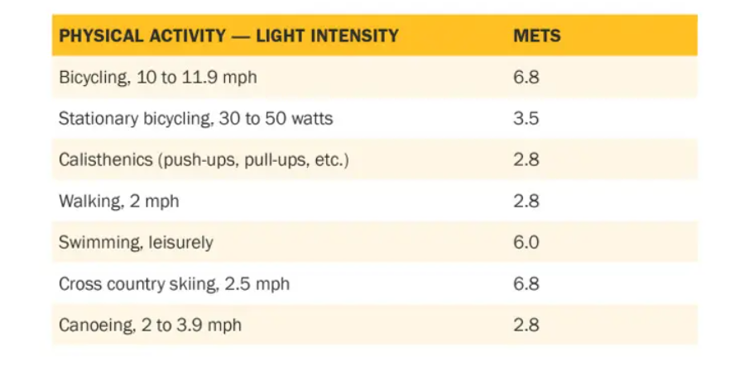
MET Values

Slide 7
PART 02
Data Collection
And Processing

Slide 8
Data Inputs
Latitude
Longitude
Speed
Acceleration
Heart Rate (collected from Apple Watch )

Slide 9
What were the problems we faced during Processing?

Slide 10
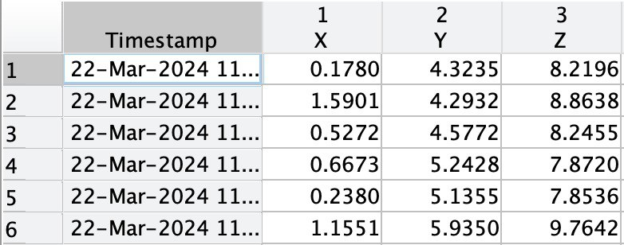
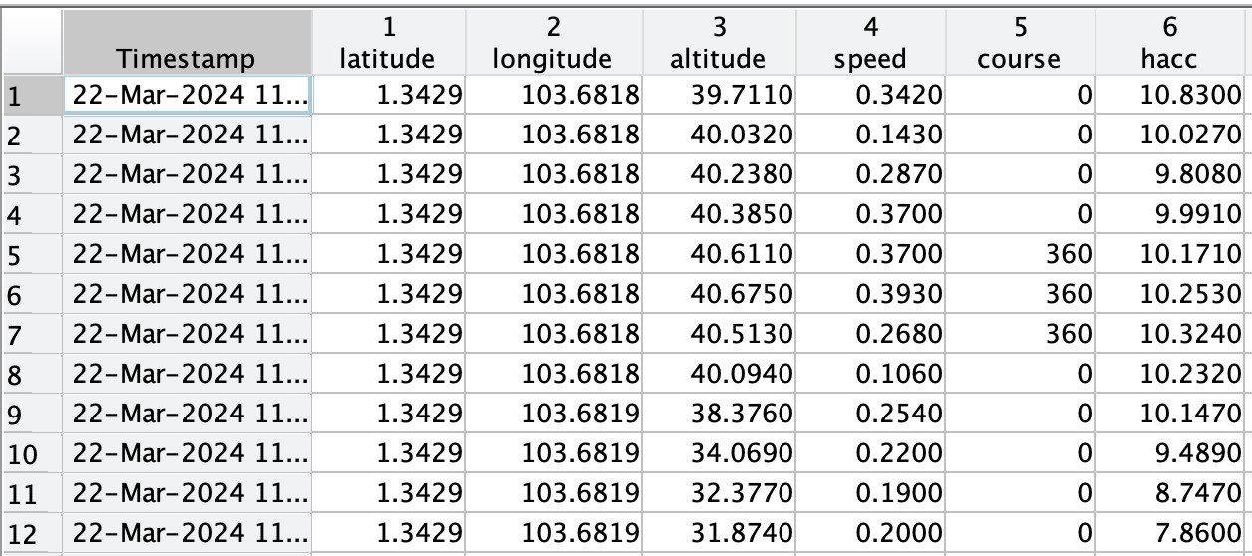
Dataset Pre Processed
Acceleration
Position

Slide 11
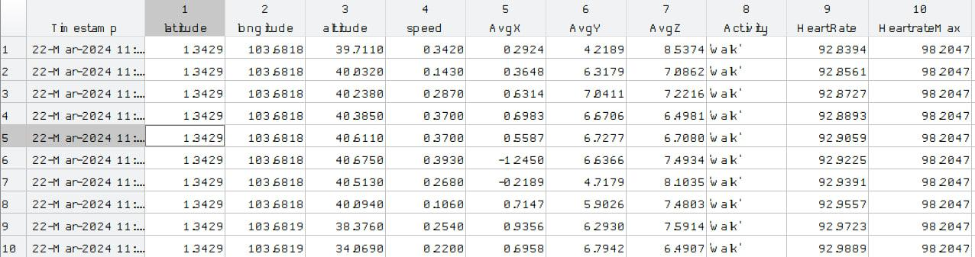
Datasets Post Processed
walk.mat

Slide 12
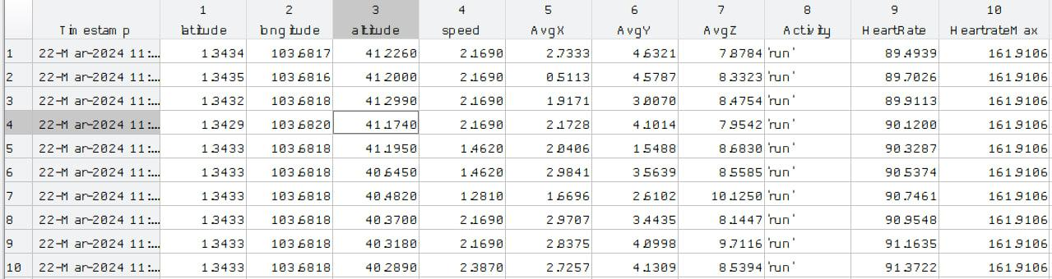
Datasets Post Processed
run.mat

Slide 13
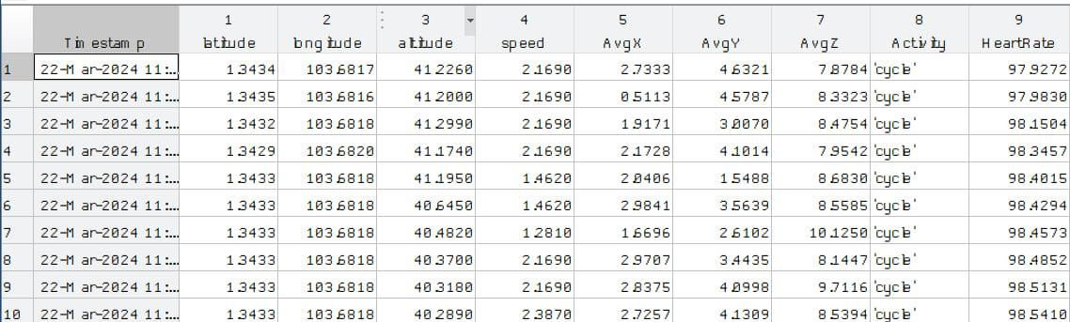
Datasets Post Processed
cycle.mat

Slide 14
PART 03
Outputs

Slide 15
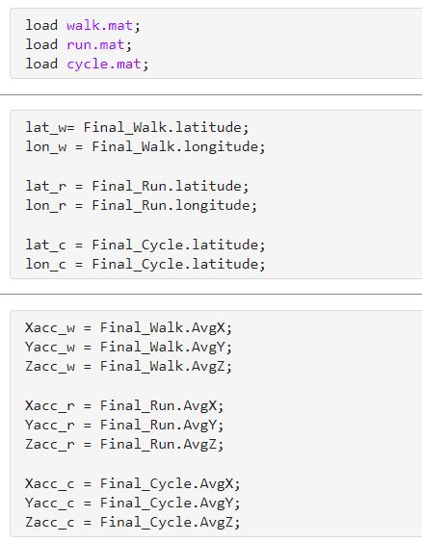
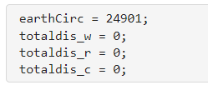
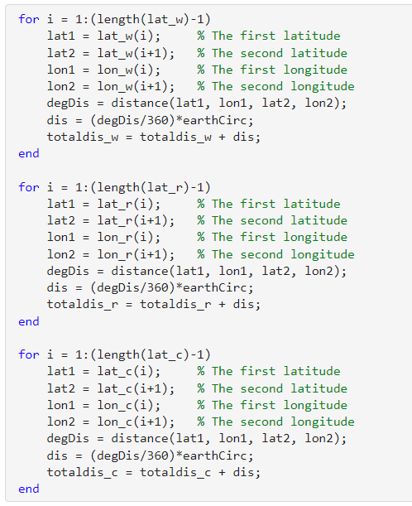
Distance Travelled and Steps

Slide 16
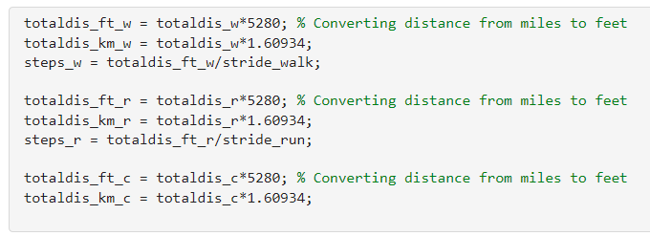
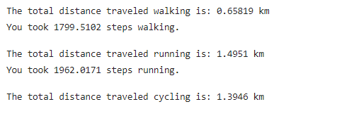
Distance Travelled and Steps

Slide 17
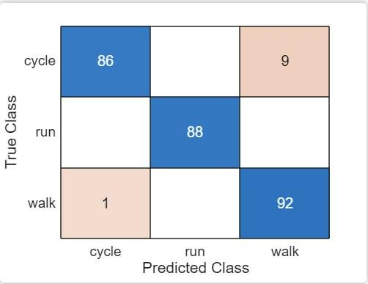
Machine Learning to predict activity
Model used Medium KNN
70-30 train test split
Results :
You know what this means?
96% ACCURACY!

Slide 18
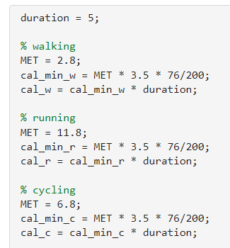

Calories Burnt

Slide 19
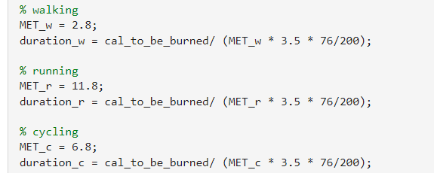

Predicting duration of activity based on desired calories to be burnt
Calories to be burned: 675

Slide 20
THANK YOU

